Slide 1
Multimedia Streaming Protocols

Slide 2
Multimedia Streaming Protocols
signalling and control protocols
  protocols conveying session setup information and VCR-like commands (play, pause, mute, setup, fast forward, backward etc.)
  ex. RTSP, SDP, SIP
real-time transport protocols
  protocols that convey the real-time data (audio, video or text)
  RTP/RTCP

Slide 3
RTP (Real-Time Transport Protocol)
is a real-time streaming protocol for IP networks
usually runs on top of UDP
is an Internet standardized packet format for transporting continuous audio-video data over Internet
was developed by the Audio-Video Transport Working Group of IETF
the standard was published as RFC 1889 in 1996 and then superseded by RFC 3550 in 2003
RTP has several profiles and payload types for different kinds of audio or video streams (e.g. MPEG-1/2/4, H.26[1234] etc.)
the RTP RFC describes also RTCP (Real Time Control Protocol) for monitoring QoS parameters
the default port is 5004

Slide 4
RTP characteristics
provides end-to-end delivery service for real-time data, in unicast and multicast sessions
offers synchronization services (timestamping), packet identification and loss detection (sequence numbering) and delivery monitoring/feedback (through RTCP)
does not provide in-order and reliable delivery of packets
does not provide timely delivery of packets, nor QoS guarantees
is independent of the transport protocol (TCP, UDP, DCCP, SCTP etc.)
a RTP session carries one multimedia stream; a RTP session is identified by a pair of triplets (IP address, RTP port, RTCP port) which are negotiated at setup using RTSP and SDP

Slide 5
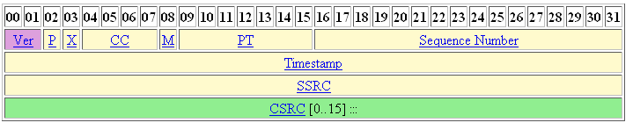
RTP packet header

Slide 6
RTP packet header (2)
version (2 bits) - RTP version number, always 2;
padding (1 bit) - if set, the packet contains padding bytes at the end of the payload; the last byte of padding contains how many padding bytes should be ignored;
extension (1 bit) - if set, the RTP header is followed by an extension header;
CSRC count (4 bits) - number of CSRCs (contributing sources) following the fixed header;
marker (1 bit) - the interpretation is defined by a profile;
payload type (7 bits) - specifies the format of the payload and is defined by an RTP profile;
sequence number (16 bits) - the sequence number of the packet; the sequence number is incremented with each packet and it can be used by the receiver to detect packet losses;
timestamp (32 bits) - reflects the sampling instance of the first byte of the RTP data packet; the timestamp must be generated by a monotonically and linearly increasing clock;
synchronization source (SSRC) (32 bits) - identifies the source of the real-time data carried by the packet;
contributing sources (CSRC) (32 bits) - identifies a maximum of 15 additional contributing sources for the payload of this RTP packet.

Slide 7
RTP header extensions
the Marker and PayloadType fields are defined by a profile and the profile may even redefine the octet containing these 2 fields
additional fixed fields can be added after the fixed header by a profile
if the X bit in the RTP header is 1, a variable-length header extension (for which the first 32 bits have a specific structure) follows the fixed header; is intended for limited use, experimenting and can be ignored by non interested applications

Slide 8
RTCP (Real-Time Control Protocol)
is described by the RTP RFC
has 2 basic functions:
  provides feedback statistics on the QoS parameters (like Round-Trip-Time, delay, jitter, packet losses etc.) for the participants to a RTP session
  carries canonical end-point identifiers (CNAME) to all session participants as the source identifier (SSRC) may change in case of a conflict and many SSRC can correspond to the same CNAME (a SSRC is unique only within a RTP session) – to keep track of each participant
uses as port the next highest odd-number following the even-number port of RTP
the RTCP traffic must not be above 5% of the RTP traffic in a session

Slide 9
RTCP packet types (reports)
SR (sender reports) – the reports sent by active senders of real-time data (audio, video)
RR (receiver reports) – the reports sent by receivers of real-time data (audio, video)
SDES – source description messages, including CNAMEs
BYE – end of participation
APP – application-specific functions
Multiple RTCP packets (reports) can be concatenated in a compound RTCP packet.

Slide 10

RTCP header
version (2 bits) – the same as for RTP header
padding (1 bit) - the same as for RTP header
count (5 bits) – the number of reception report blocks contained in this packet
type (8 bits) – the packet type (193 – NACK, 200 – SR report, 201 – RR report, 202 – SDES packet, 203 – BYE packet, 204 – APP packet)
length (16 bits) – the length of the RTCP packet in 32 bit words minus one, including the header and padding

Slide 11
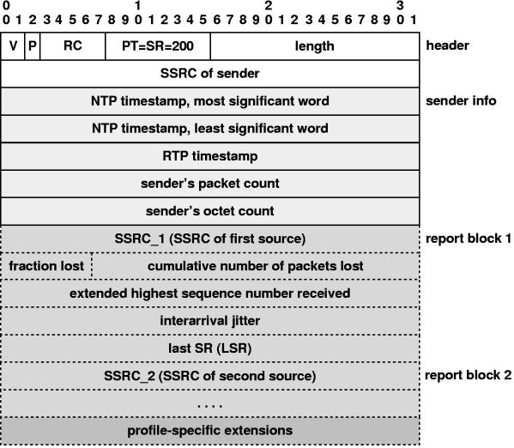
RTCP SR packet

Slide 12
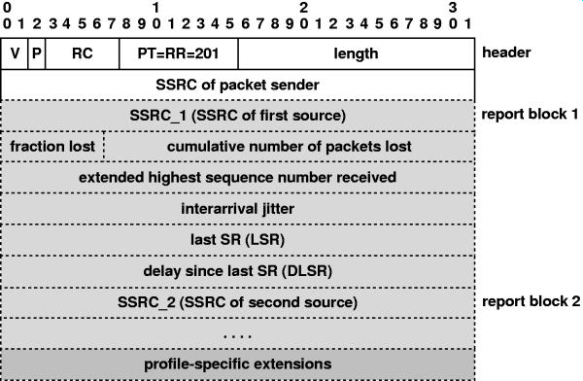
RTCP RR packet

Slide 13
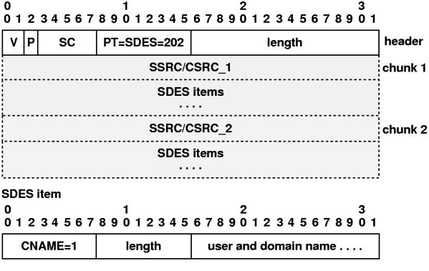
RTCP SDES packet

Slide 14
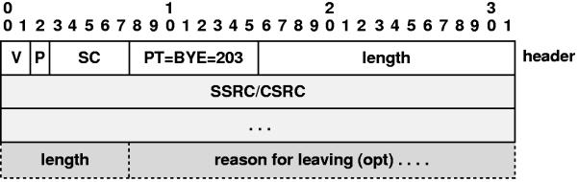
RTCP BYE packet

Slide 15
RTP profiles (Payload Types)
RFC 2032 – RTP payload format for H.261 Video streams
RFC 2190 - RTP payload format for H.263 Video streams
RFC 2250 – RTP payload format for MPEG1/MPEG2 video
RFC 3984 - RTP payload format for H.264 Video streams
RFC 3016 – RTP payload format for MPEG-4 Audio/Visual streams
RFC 2435 – RTP payload format for JPEG-compressed video
RFC 3551 – RTP profile for Audio ad Video conferences with minimal control
RFC 3640 - RTP payload format for transport of MPEG-4 Elementary Streams
RFC 4175 – RTP payload format for uncompressed video

Slide 16
RTSP – Real-Time Streaming Protocol

Slide 17
RTSP
is a signalling and control protocol for multimedia streaming in Internet
used to control the data delivery in a multimedia streaming session by conveying VCR-style commands (like play, mute) between communicating partners; it is typically used in conjunction with RTP which conveys the actual multimedia data.
is a request-response protocol similar to HTTP, but stateless
is standardized by the Multiparty Multimedia Session Control Working Group (MMUSIC WG) of the IETF in 1998 in RFC 2326
the default port is 554

Slide 18
RTSP Request
has the form:
Request-Method SP Request-URL SP RTSP-Version <CR><LF>
(generic-header | request-header | entity-header <CR><LF>)
<CR><LF>
[message body]
Request-Method is:
  DESCRIBE - retrieves the description of a media object from a server;
  SETUP - prepares the streaming session;
  PLAY - starts the delivery of multimedia data;
  PAUSE - streaming is paused, session is still active, but no packet is sent;
  TEARDOWN - session is terminated and resources are freed.

Slide 19
RTSP Request (2)
Request-header can have the following fields (selection):
  Accept : MIME types of resources accepted by client
  Accept-Encoding : encoding accepted by client
  Accept-Language : language accepted by client
  Authorization : user-agent wishes to authenticate itself with a server
  From:
  Referer : the URL of document refering this URL
  User-Agent : client software

Slide 20
RTSP Response
has the form:
Http-Version SP Status-Code SP Reason-Phrase<CR><LF>
(generic-header | response-header | entity-header <CR><LF>)
<CR><LF>
[message body]
Response-header has the following fields (selection):
  Location : redirect the client to a location other than Request-URL for completion of the request
  Retry-After : indicate to client how long the service is expected to be unavailable
  Server : information about software used by the server to handle the request

Slide 21
Describe Request Ex.
The Describe command retrieves the description of media object. The client normally issues a Describe command requesting a description of a media object identified by a URL and the server replies with a SDP message which characterizes that media object. A typical Describe request sent by the client to the server looks like this:
DESCRIBE rtsp://server.example.com:5556/foo RTSP/1.0
CSeq: 12
Accept: application/sdp, application/rtsl, application/mheg
The first line contains the URL of the requested media object and the version of the RTSP protocol. The second line contains a sequence number which identifies an RTSP request-response pair. This field is incremented for following request-response pairs. The final line specifies what kind of descriptions of a media object the client accepts.

Slide 22
Response to Describe
The server will typically reply with the following to a Describe command:
RTSP/1.0 200 OK
CSeq: 12
Date: 19 December 2008 11:30:00 GMT+2
Content-Type: application/sdp
Content-Length: 376
[... SDP message ...]
The first line specifies a result code (200 means success like in HTTP). The second line contains the same sequence number as the corresponding Describe request of the client. The third line contains the date. The next two lines describe the body of the response which is a SDP message.

Slide 23
Setup Request Ex.
The Setup command is used for specifying the transport mechanism used for multimedia data. A typical Setup request sent by the client to the server looks like this:
SETUP rtsp://server.example.com:5556/foo/foo.avi RTSP/1.0
CSeq: 13
Transport: RTP/AVP;unicast;client_port=4588-4589
The request specifies the transmission parameters acceptable to the client: the RTP protocol with the AVP profile and the ports 4588, 4589.

Slide 24
Response to Setup
The Setup response sent by the server to the client has the form:
RTSP/1.0 200 OK
CSeq: 13
Date: 19 December 2008 11:30:00 GMT+2
Session: 12345678
Transport: RTP/AVP;unicast;
client_port=4588-4589;server_port=6256-6257
The response specifies the transport mechanism agreed by the server. The Setup response also contains a session identifier generated by the server.

Slide 25
A Play Request-Response Ex.
The Play command initiates the transmission of multimedia data. The request sent by the client has the form:
PLAY rtsp://server.example.com:5556 RTSP/1.0
CSeq: 14
Session: 12345678
Range: 0.0 - 25.30
The server will typically reply with an OK response:
RTSP/1.0 200 OK
CSeq: 14

Slide 26
SDP – Session Description Protocol

Slide 27
SDP
is a protocol used to describe media objects and presentations
usually, in multimedia streaming, SDP messages are sent in RTSP requests
a SDP message contains information about the session, the media streams included in the session and information necessary to receive the media (e.g. IP addresses, ports, formats etc.)
is standardized by IETF first in 1998 and then as RFC 4566 in 2006

Slide 28
Session Description
v= (protocol version)
o= (originator and session identifier)
s= (session name)
i=* (session information)
u=* (URI of description)
e=* (email address)
p=* (phone number)
c=* (connection information -- not required if included in all media)
b=* (zero or more bandwidth information lines)
One or more time descriptions ("t=" and "r=" lines)
z=* (time zone adjustments)
k=* (encryption key)
a=* (zero or more session attribute lines)
Zero or more media descriptions

Slide 29
Time and Media Description
Time description:
t= (time the session is active)
r=* (zero or more repeat times)
Media description, if present :
m= (media name and transport address)
i=* (media title)
c=* (connection information -- optional if included at session level) b=* (zero or more bandwidth information lines)
k=* (encryption key)
a=* (zero or more media attribute lines)
The ”a=” attribute specifies attributes of the session like: stream duration, codec information, stream format, spatial sizes of the format etc.

Slide 30
A SDP message example
v=0
o=StreamingServer 1243955941 342225 IN IP4 172.30.0.1
s=movie.avi
e=admin@scs.ubbcluj.ro
c=IN IP4 172.30.0.1
t=0 100
a=range:npt=0-13.23300
m=video 0 RTP/AVP 96
b=AS:1514
a=rtpmap:96 MP4V-ES/90000
a=fmtp:96 profile-level-id=1
a=cliprect:0,0,352,288

